Slide 1
Pipelining and parallel processing: Basics of pipelining, pipeline hazards, techniques for handling hazards, parallel processing architectures (Lecture 35-39)

Slide 2
Contents
Parallel processing
Pipelining
Arithmetic pipelining
Pipeline hazards, techniques for handling hazards

Slide 3
Parallel Processing
Parallel processing refers to a computing technique where multiple tasks or computations are carried out simultaneously. Instead of executing instructions one after another in a sequential manner, parallel processing enables multiple instructions to be executed at the same time, thereby improving efficiency and performance.
For example, while an instruction is being executed in the ALU , the next instruction can be read from memory. The system may have two or more ALUs and be able to execute two or more instructions at the same time.
Furthermore, the system may have two or more processors operating currently.
To improve the performance of a CPU we have two options:
1) Improve the hardware by introducing faster circuits. Since there is a limit on the speed of hardware and the cost of faster circuits is quite high.
2) Parallel Processing:- Arrange the hardware such that more than one operation can be performed at the same time.

Slide 4
Processor with Multiple Functional Units
As shown in figure 1, one possible way of separating the execution unit into eight functional units operating in parallel. The operands in the registers are applied to one of the units depending on the operation specified by the instruction associated with the operands.
The operation performed in each functional unit is indicated in each block of the diagram.
The adder and integer multiplier perform the arithmetic operations with integer numbers.
The floating-point operations are separated into three circuits operating in parallel.
The logic, shift, and increment operations can be performed concurrently on different data.
All units are independent of each other, so one number can be shifted while another number is being incremented.
A multifunctional organization is usually associated with a complex control unit to coordinate all the activities among the various components.

Slide 5
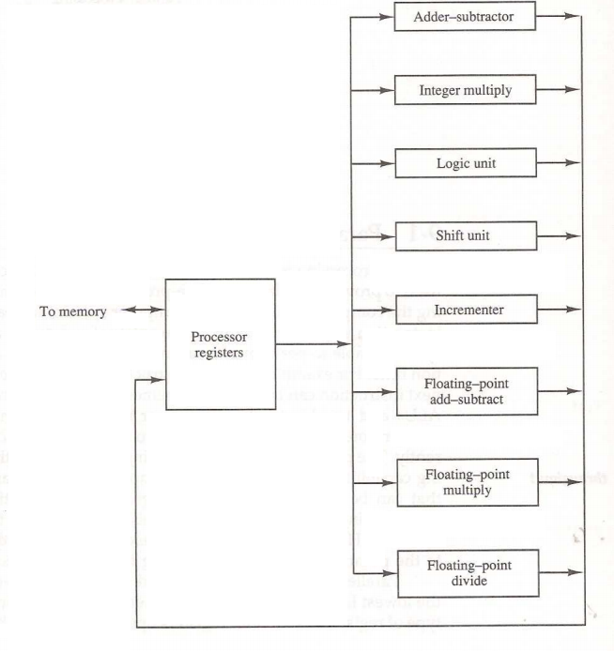
Processor with Multiple Functional Units
Figure1: Processor with multiple functional Units

Slide 6
Classification of Parallel Processing
There are a number of ways that parallel processing can be classified.
It can be on the basis of following:-
Internal organization of the processors.
Interconnection structure between processors.
Flow of information through the system.
One Classification introduced by M.J.Flynn considers the organization of a computer system by the number of instructions (instruction stream) and data items (data stream) that are manipulated simultaneously.
Flynn’s classifications divides computers into four major groups:
Single instruction stream, single data stream(SISD)
Single instruction stream, multiple data stream(SIMD)
Multiple instruction stream, single data stream(MISD)
Multiple instruction stream, multiple data stream (MIMD)

Slide 7
Classification of Parallel Processing
The four categories in Flynn's classification are:
SISD (Single Instruction, Single Data): Traditional von Neumann architecture where one instruction operates on one piece of data at a time. This is the simplest and most common type.
SIMD (Single Instruction, Multiple Data): Multiple processing units execute the same instruction on multiple pieces of data simultaneously. This is common in vector processing and array operations.
MISD (Multiple Instruction, Single Data): Multiple instructions operate on the same piece of data concurrently. While theoretically possible, it's not widely implemented in practical architectures.
MIMD (Multiple Instruction, Multiple Data): Multiple processing units execute different instructions on different pieces of data simultaneously. This is common in multi-core processors and parallel computing systems.

Slide 8
Pipelining
Pipelining is a technique used in computer architecture to improve the performance and throughput of CPUs and other processing units by overlapping the execution of multiple instructions. It breaks down the execution of instructions into several stages, with each stage handling a specific part of the instruction execution process. As a result, multiple instructions can be in different stages of execution simultaneously, increasing overall efficiency and speed.
In computing, pipelining is also known as pipeline processing. It is sometimes compared to a manufacturing assembly line in which different parts of a product are assembled simultaneously, even though some parts may have to be assembled before others. Even if there is some sequential dependency, many operations can proceed concurrently, which facilitates overall time savings.
However, pipelining also introduces challenges such as data hazards (dependencies between instructions), control hazards (branch instructions), and structural hazards (resource conflicts), which need to be managed through techniques like forwarding, stalling, and branch prediction.

Slide 9

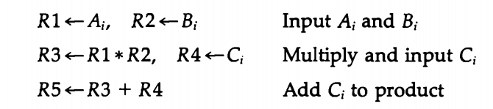
Pipelining (Example)
Example:
Suppose that we want to perform the combined multiply and add operations with a stream of numbers.
Each sub operation is to be implemented in a segment within a pipeline. Each segment has one or two registers and a combinational circuit as shown in below Fig. 2. R1 through R5 are registers that receive new data with every clock pulse. The multiplier and adder are combinational circuits. The sub operations performed in each segment of the pipeline are as follows:

Slide 10
Pipelining (Example)
The 5 registers are loaded with new data every clock plus.
The effect of each clock is shown in table. The first clock pulse transfers A1 and B1 into R2.
The second clock pulse transfers the product of R1 and R2 into R3 and C into R4.
The same clock pulse transfers Az and B2 into R1 and R2.
The third clock pulse operates on all three segments simultaneously.
It places dy and Bz into R1 and R2, transfers the product of R1 and R2 into R3, transfers Cz into R4, and places the sum of R3 and R4 into R5.
It takes three clock pulses to fill up the pipe and retrieve the first output from R5.
From there on, each clock produces a new output and moves the data one step down the pipeline. This happens as long as new input data flow into the system.
When no more input data are available, the clock must continue until the last output emerges out of the pipeline.

Slide 11
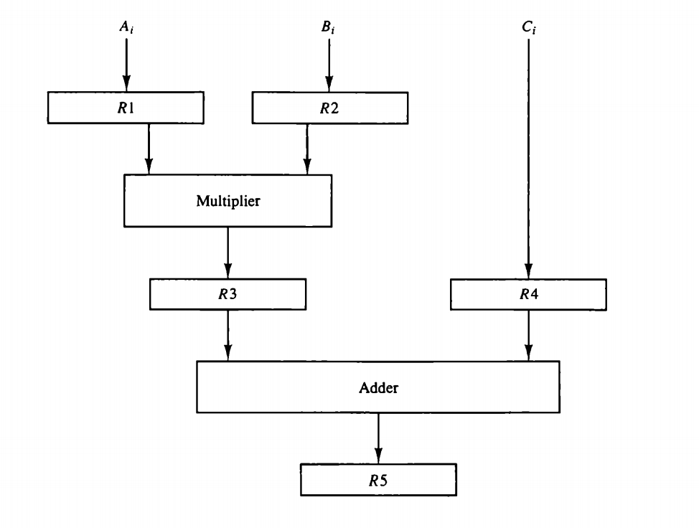
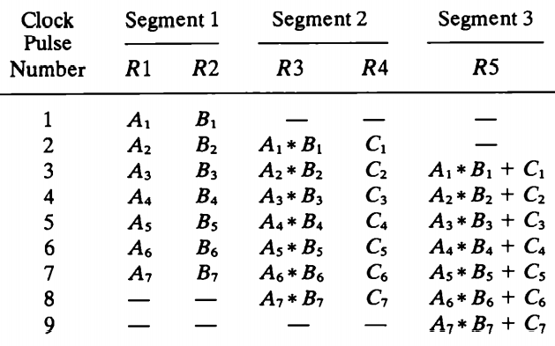
Pipelining
Content of Registers in Pipeline Example
Figure 2 Pipeline processing

Slide 12
General Considerations
Any operation that can be decomposed into a sequence of sub operations of about the same complexity can be implemented by a pipeline processor.
The technique is efficient for those applications that need to repeat the same task many times with different sets of data.
The general structure of a four-segment pipeline is illustrated in Fig. 3.
The operands pass through all four segments in a fixed sequence.
Each segment consists of a combinational circuit S; that performs a sub operation over the data stream flowing through the pipe.
The segments are separated by registers R; that hold the intermediate results between the stages. Information flows between adjacent stages under the control of a common clock applied to all the registers simultaneously.
We define a task as the total operation performed going through all the segments in the pipeline.
The behavior of a pipeline can be illustrated with a space-time diagram.
This is a diagram that shows the segment utilization as a function of time. The space-time diagram of a four-segment pipeline is demonstrated in Fig. 4.
The horizontal axis displays the time in clock cycles and the vertical axis gives the segment number.

Slide 13
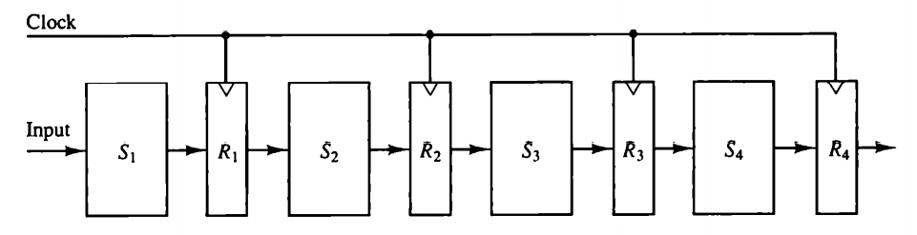
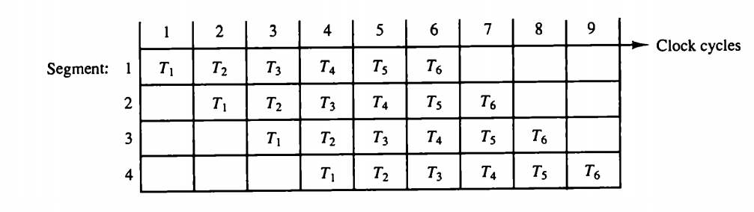
General Considerations
Figure 3 Four segment pipeline
Figure 4 Space time diagram for pipeline

Slide 14
General Considerations
The diagram shows six tasks T, through To executed in four segments. Initially, task Ti is handled by segment 1. After the first clock, segment 2 is busy with Ti, while segment 1 is busy with task Tz. Continuing in this manner, the first task Ti is completed after the fourth clock cycle. From then on, the pipe completes a task every clock cycle.
No matter how many segments there are in the system, once the pipeline is full, it takes only one clock period to obtain an output. Now consider the case where a k-segment pipeline with a clock cycle time to is used to execute n tasks.
The first task Ti requires a time equal to kt, to complete its operation since there are k segments in the pipe.
The remaining n - 1 tasks emerge from the pipe at the rate of one task per clock cycle and they will be completed after a time equal to (n − 1)tp.

Slide 15


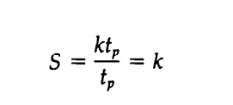
Therefore, to complete n tasks using a k-segment pipeline requires k + (n − 1) clock cycles. For example, the diagram of Fig. 4 shows four segments and six tasks.
The time required to complete all the operations is 4 + (6 – 1) = 9 clock cycles, as indicated in the diagram.
Next consider a non pipeline unit that performs the same operation and takes a time equal to t, to complete each task. The total time required for n tasks is nt .
The speedup of a pipeline processing over an equivalent non pipeline processing is defined by the ratio
As the number of tasks increases, n becomes much larger than k – 1, and k + n - 1 approaches the value of n. Under this condition, the speedup becomes
If we assume that the time it takes to process a task is the same in the pipeline and non pipeline circuits, we will have tn = kty. Including this assumption, the speedup reduces to

Slide 16
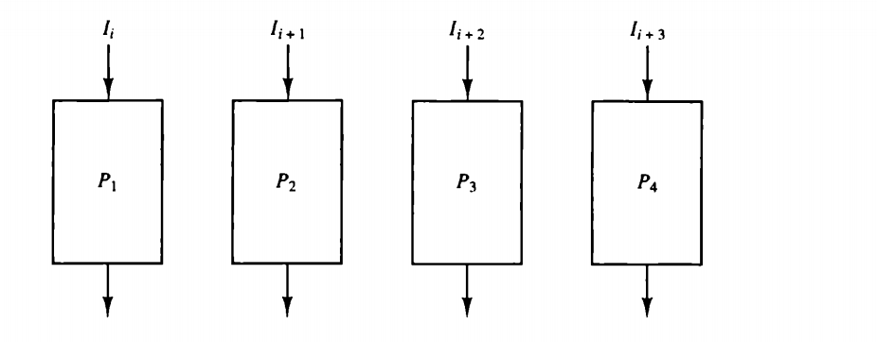
General Considerations
This shows that the theoretical maximum speedup that a pipeline can provide is k, where k is the number of segments in the pipeline.
To clarify the meaning of the speedup ratio, consider the following numerical example.
Let the time it takes to process a sub operation in each segment be equal to tp, = 20 ns.
Assume that the pipeline has k = 4 segments and executes n = 100 tasks in sequence.
The pipeline system will take (k + n - 1)tp = (4 + 99) × 20 = 2060 ns to complete.
Assuming that tn = ktp = 4 x 20 = 80ns, a non pipeline system requires nktp = 100 X 80 = 8000 ns to complete the 100 tasks.
The speedup ratio is equal to 8000/2060 = 3.88. As the number of tasks increases, the speedup will approach 4, which is equal to the number of segments in the pipeline.
If we assume that tn = 60 ns, the speedup becomes 60/20 = 3.
Figure 5 Multiple Functional units in parallel

Slide 17
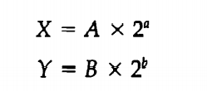
Arithmetic Pipelining
Pipeline arithmetic units are usually found in very high speed computers.
They are used to implement floating-point operations, multiplication of fixed-point numbers, and similar computations encountered in scientific problems.
The inputs to the floating-point adder pipeline are two normalized floating-point binary numbers.
A and B are two fractions that represent the mantissas and a and b are the exponents.
The floating-point addition and subtraction can be performed in four segments, as shown in Fig. 6.
The registers labeled R are placed between the segments to store intermediate results.
The suboperations that are performed in the four segments are:
1. Compare the exponents.
2. Align the mantissas.
3. Add or subtract the mantissas.
4. Normalize the result.

Slide 18
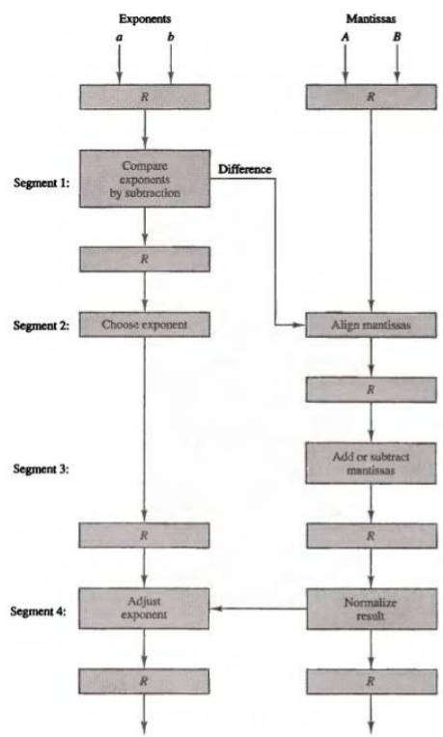
Arithmetic Pipelining
The following numerical example may clarify the sub operations performed in each segment.
For simplicity, we use decimal numbers, although Fig.6 refers to binary numbers.
Consider the two normalized floating-point numbers:
X = 0.9504 x 10³ ………….1
Y = 0.8200 x 10²…………...2
The two exponents are subtracted in the first segment to obtain 3 - 2 = 1. The larger exponent 3 is chosen as the exponent of the result. The next segment shifts the mantissa of Y to the right to obtain
X = 0.9504 x 10³ ………….3
Y = 0.0820 x 10³…………..4
This aligns the two mantissas under the same exponent. The addition of the two mantissas in segment 3 produces the sum
Z = 1.0324 x 10³………….5
Z = 1.0324 x 10⁴………….6
Figure 6 Pipeline for floating -point addition and subtraction

Slide 19
The Concept of Pipeline Hazards
Pipeline Hazards are often seen as missteps in the optimisation of processes within the pipelining concept.
Understanding pipeline hazards require a solid comprehension of how pipelining works in the first place. In a nutshell, pipelining is a technique where multiple instructions are overlapped during execution.
However, certain conditions can interfere with the smooth flow of this process - hence leading to pipeline hazards.
There are three stages in the instruction cycle where a pipeline hazard can occur: during instruction fetch, during instruction decode, and during instruction execute.
The hazards that occur with the instruction fetch are usually related to issues with the memory system such as latency.
.

Slide 20
The Concept of Pipeline Hazards
A common example of this is if two instructions that are close to each other in the instruction stream need to access the same memory location, a conflict termed as a conflict miss, may occur.
During the decoding stage, an instruction might need to wait for the completion of another instruction which currently occupies the decoder.
This could happen if, for example, a comparator check fails to have the expected output.
Lastly, hazards during the execution stage can occur if there is contentious access to a functional unit like Register File, ALU etc.

Slide 21
Different Types of Pipeline Hazards
Structural Hazards: These occur when the same hardware resource is desired by multiple instructions at the same time.
Data Hazards: They come into play when the execution of one instruction depends on the completion of another.
Control Hazards: These result from the pipelining of branches and other instructions that change the PC.
Control Hazards in Pipelining
Control hazards are one of the most complex types of pipeline hazards because of their connection to the control flow of the program. Control hazards come from the pipelining of branches and other instructions that cause changes to the PC

Slide 22
Data Hazards in Pipelining
Data hazards occur when there is a conflict in the access or use of operand data.
These can be categorized into three types: read-after-write (RAW), write-after-read (WAR), and write-after-write (WAW).
A RAW hazard, also known as a true dependency, occurs when an instruction depends on the result of a previous instruction.
A WAR hazard occurs when an instruction depends on the reading of a value before that value is overwritten by a previous instruction.
A WAW hazard occurs when a value is written by an instruction before the previous instruction writes that value.

Slide 23
Analysing Control Hazards in Pipelining Example
Pipelining is an effective way to increase instruction throughput and improve the performance of your computer.
However, this methodology isn't without its complications.
Particular problem areas occur when control flow instructions like branches and jumps are pipelined.
They can lead to delays in instruction execution due to Pipeline Hazards, particularly Control Hazards.

Slide 24
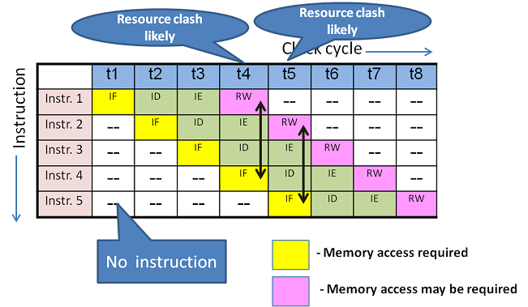
Structural dependency scenario

Slide 25
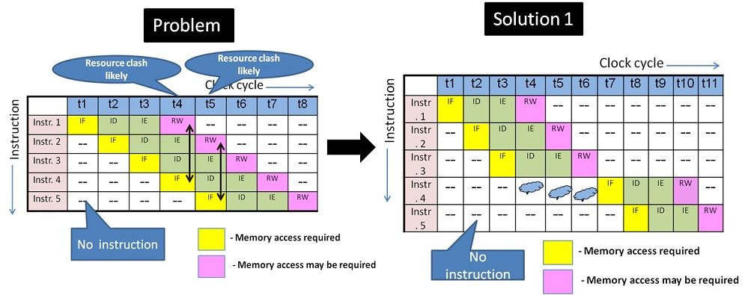
Structural Hazard solution using "stall" in a 4 stage pipeline design

Slide 26
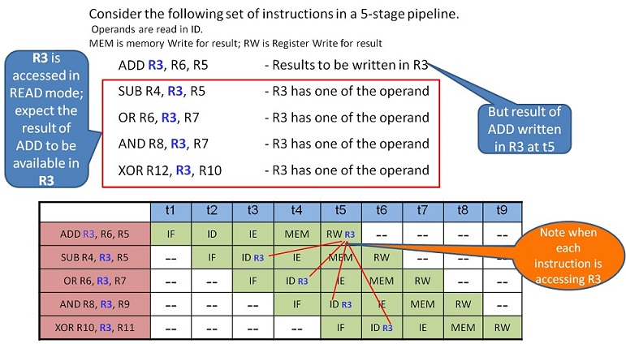
Data Hazard scenario

Slide 27
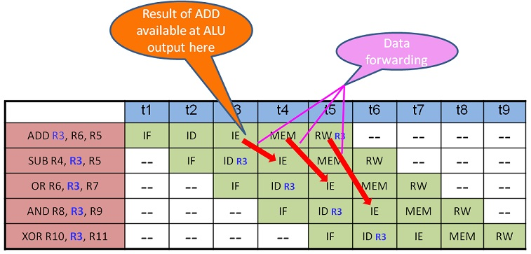
Data forwarding solution for Data Hazard

Slide 28
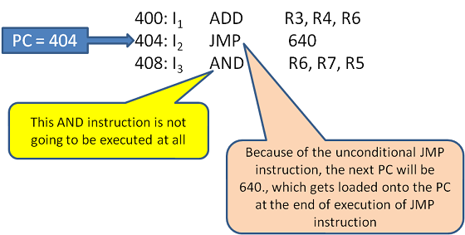
Control Hazard scenario

